Slide 1
Project - Let’s Play FIFA!
29th October 2021
Sangani Bhavin Pravinbhai
Himanshu Bhardwaj
Lakshmanan L
P Ashish

Slide 2
Table of Contents
Problem Statement
Methodology
Part A – Predict Player Rating
Part B – Predict Player Position
Part C – Rank the best staff
Drawbacks and Next Steps

Slide 3
Problem Statement
3 part problem statement to analyze the FIFA(video game) data from 2015 to 2020
ID | Problem Statement | Approach | Training Data | Test Data | Evaluation Criteria
Part A | Predict Player Rank | Regression Model | 2019 Data | 2020 - Select Clubs | MSE for player rating
Part B | Predict Player Position | Classification Model | 2019 Data | 2020 – Select Clubs | Classification Accuracy (If the predicted position is one of the actual player positions it is classified correctly)
Part C | Rank the best staff | No Model - Rank the clubs based on growth of the players | 2015-2020 Data | - | We have used growth of player reputation to see if the club has hepled players in improving or not

Slide 4
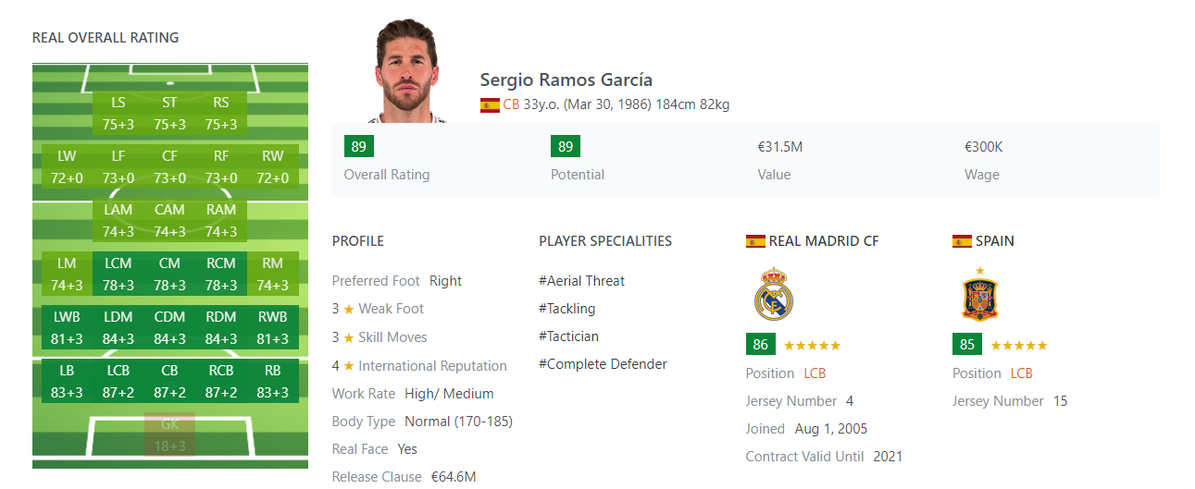
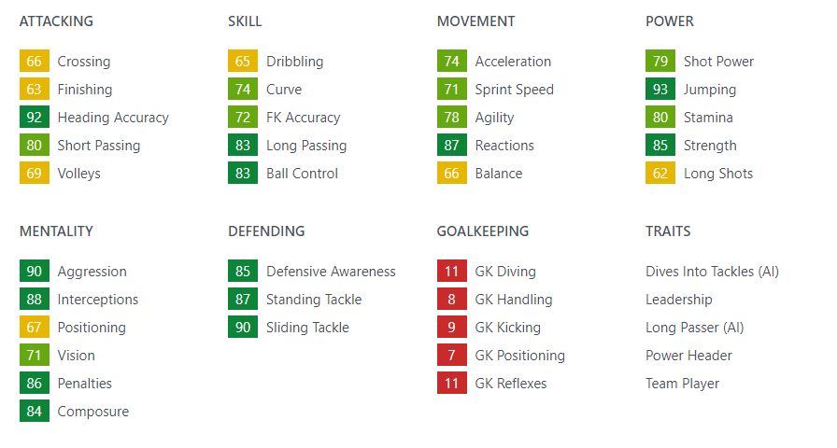
Methodology
Language Used | Python
Key Packages Used | Data Handling - Pandas, Numpy Modelling – sklearn, Keras Visualization – Seaborn,Matplotlib
Key Data Used | Positional Ratings Overall Rating Wage/Salary/ Release Clause (not used for Part B) Characteristics Club Contract details Skill details
1
2
3
4
5
6

Slide 5
Part A : Predict Player Rank - Approach
Data Preparation
Training Data Used – 2019 data (80% train) Data Preparation : Python function is developed to do all the basic data cleaning activities like dropping duplicate and irrelevant columns. Other key steps – 1) Categorical Features – One Hot Encoding 2) Missing Values Imputation – Mode or Zeroes 3) Player Positions – First position is used 4) Date Columns – Converted to year or age
Algorithms Used
Step 1 – Selecting Features: Lasso Regression is used to select relevant features – All features with beta value of >0.1 are selected for further analysis Step 2 – Predicting Rank: Used a neural network with selected features to predict the player rank
Result
20% Test Data – On the 20% test data, results – Linear Regression (MSE : 5.95) Lasso Regression with best alpha (MSE: 6.03) Neural Network (MSE: 1.033) Selected Clubs (Private Test) - On the Given Test Data of selected clubs in 2020 MSE of the final model is found to be 1.47

Slide 6

Part A – Predict Player Rank - Results
Final Model Details
Predicted Top 5 Results (2020 Test Clubs Only)
Details of the neural network :
Activation Function – ReLU
Optimizer – Adam
Loss Metric – MSE
Early Stopping – Yes
Epochs - 30
Sl. No | Player Name | Predicted Rank | Actual Rank
1 | L. Messi | 94 | 94
2 | C. Ronaldo | 92 | 93
3 | Neymar Jr | 91 | 92
4 | E. Hazard | 91 | 91
5 | K. De Bruyne | 91 | 91

Slide 7
Part B – Predict Player Position – Approach
Data Preparation
Training Data Used – 2019 data (75% train) Data Preparation – Key steps – 1) Categorical Features – One Hot Encoding 2) Missing Values Imputation – Mode 3) Player Positions – First position is used 4) Date Columns – Converted to year or age 5) Target Variable – Player Position is label encoded
Algorithms Used
2 Models were tried : Logistic Regression : didn’t give good results. Classification accuracy of only 17% observed Neural Network : Using Neural Network yielded a Classification accuracy of 78% Neural network Model details – Activation Function – ReLU and Softmax Dropout - Yes Optimizer – Adam Loss Metric – Cosine Similarity Early Stopping – Yes Epochs - 200
Result
25% Test Data – On the 25% test data, results – Logistic Regression (Accuracy – 17%) Neural Network (Accuracy – 78%) Selected Clubs (Private Test) – After changing the accuracy criteria to be correct if we predict any of the player position, on the Given Test Data of selected clubs in 2020 accuracy of the final model is 88%

Slide 8
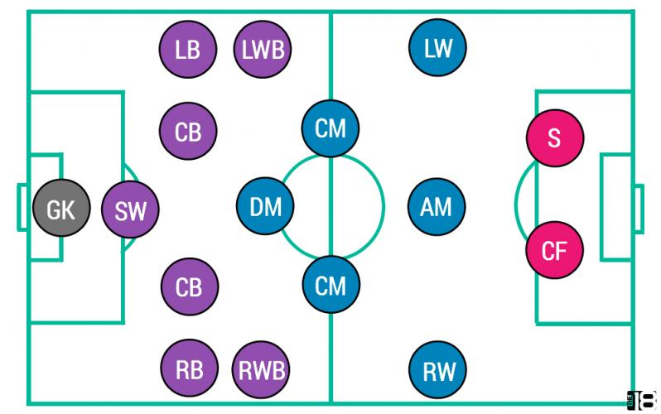
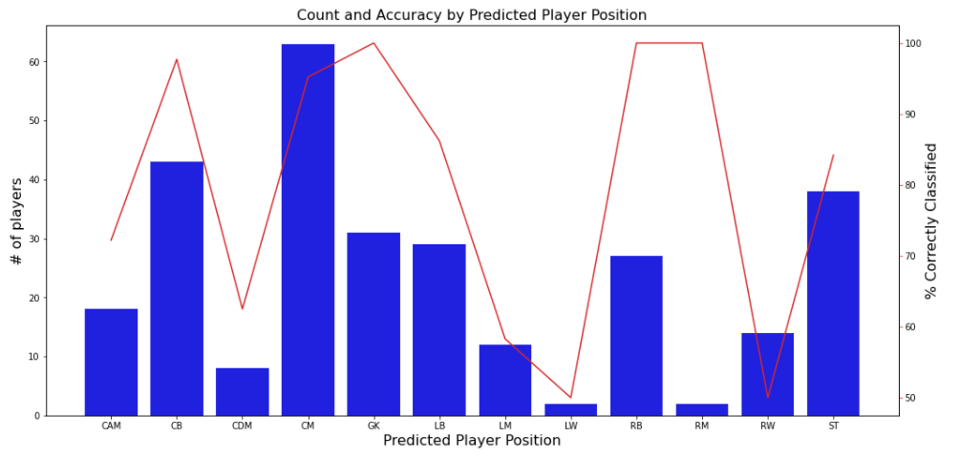
Part B – Predict Player Position - Results
For each of the predicted positions, number of players is shown as a bar and line shows the accuracy.
For positions with high volume like CM, CB, GK, RB we have very high accuracy of >95%
For positions with lower volume like LW, RW, L, CDM we seem to have lower accuracy

Slide 9
Part C – Which club has the best staff?
How do we decide which club has best staff?
Approach :
If the player’s skills and ratings increase, it means the club has good staff.We took all the skills and ratings columns and identified the percentage growth between 2015 and 2020 at a club level. This rating is converted into a score column, which serve as a metric to identify good staffs
How can we be sure we did a good job in rating the best staff?
Approach :
We calculated the international reputation of these players and compared their percentage growth between 2015 and 2020
Top 5 Clubs
Club Rank | Club | Staff score based on player skill growth | % growth in international reputation score
1 | RCD Espanyol | 100 | 27%
2 | Angers SCO | 86
3 | OGC Nice | 80
4 | RC Celta | 79
5 | FC Nantes | 76
Bottom 5 Clubs
Club Rank | Club | Staff score based on player skill growth | % growth in international reputation score
58 | Inter | 16 | 12.5%
59 | Crystal Palace | 15
60 | Borussia Dortmund | 14
61 | Everton | 8
62 | Milan | 0

Slide 10
Drawbacks and Ideas to improve
ID | Problem Statement | Result | Ideas to improve
Part A | Predict Player Rank | MSE – 1.26 | While we already predict the player rank with + or – 1 difference, there is still some improvement required w.r.t to the rank ordering of the results. Ranks sometime get shuffled. Creating more features, Training on older/2020 data could help.
Part B | Predict Player Position | Accuracy – 88% | Scope to predict all the player positions and not just 1. More features to distinguish among the player classes (e.g. LW is misclassified as RW). Focus on low volume positions’ misclassification rate
Part C | Rank the best staff | -- | Assumption is the player’s growth fully gets attributed to 2015 club. Ideally the growth should get attributed based on the time spent and if there was any growth during that time.

Slide 11
Thank You

